Slide 1


GROUP 5 CLASS E
CREDPAL PREDICTIVE ANALYTICS

Slide 2

GROUP MEMBERS
RUKAYAT SALAU
ESTHER EDIJALA
ANESU CHADZIYA
VICTORIA ELUMA
OLAJUMOKE IBITOYE
CHISOM ANAEDUM
ADENIKE AWOTUNDE
PORTIA AMANKWAH
DEBORAH OZUEM
ELIZABETH OLAGUNJU
RIRHANDZU NOVELA

Slide 3
CASE SUMMARY
Stripe, a software technology company based in San Francisco decided to invest 2.9 million USD in CredPal. As part of the journey to understanding consumer’s saving capability, Stripe developed an internal project with the aim of analyzing consumers’ spending habits at different levels and regions. This analysis is critical because it aims to demonstrate the scalability of the CredPal solution and validate its argument that users (from different countries) have a spending pattern and a capability to save.

Slide 4
PROJECT GOAL
Our team of analysts has been tasked to work with and analyze the data set and extract relevant intelligence to help guide the investment team from Stripe.
To analyze the dataset and visualize our findings, we will be working with the following tools:
Power BI
Tableau
Google Looker Studio

Slide 5
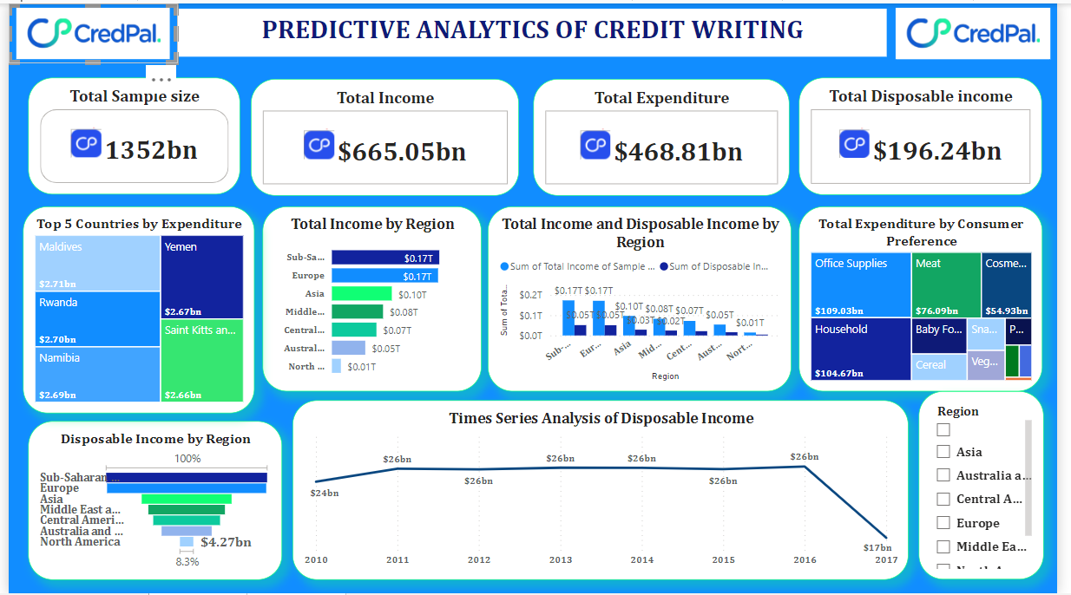
POWER BI DASHBOARD

Slide 6
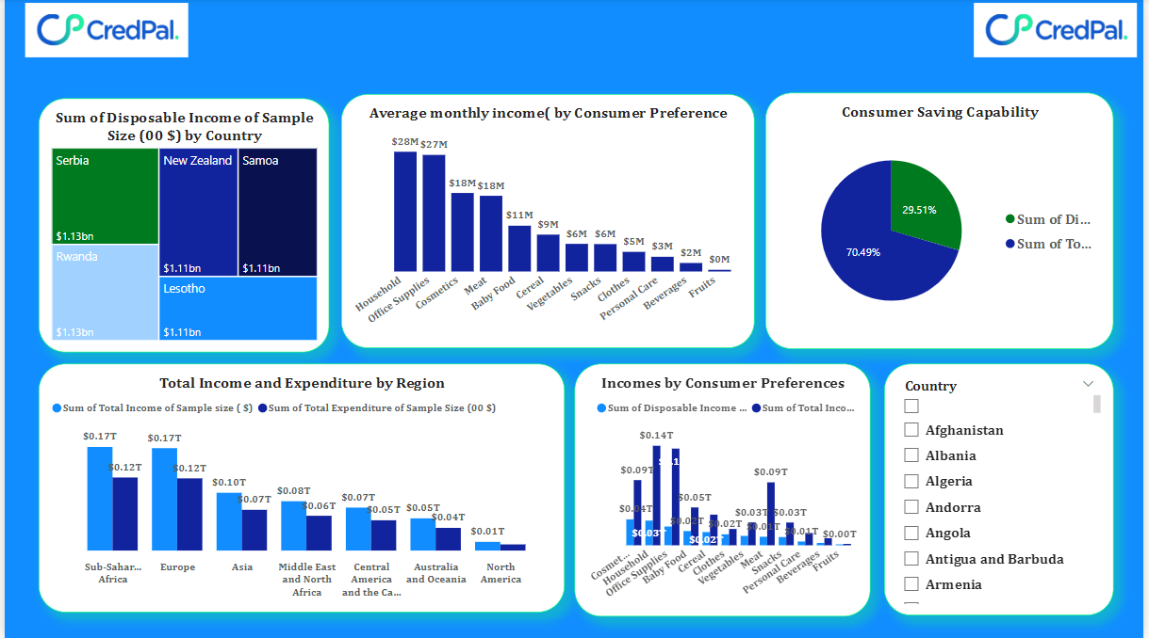

Slide 7
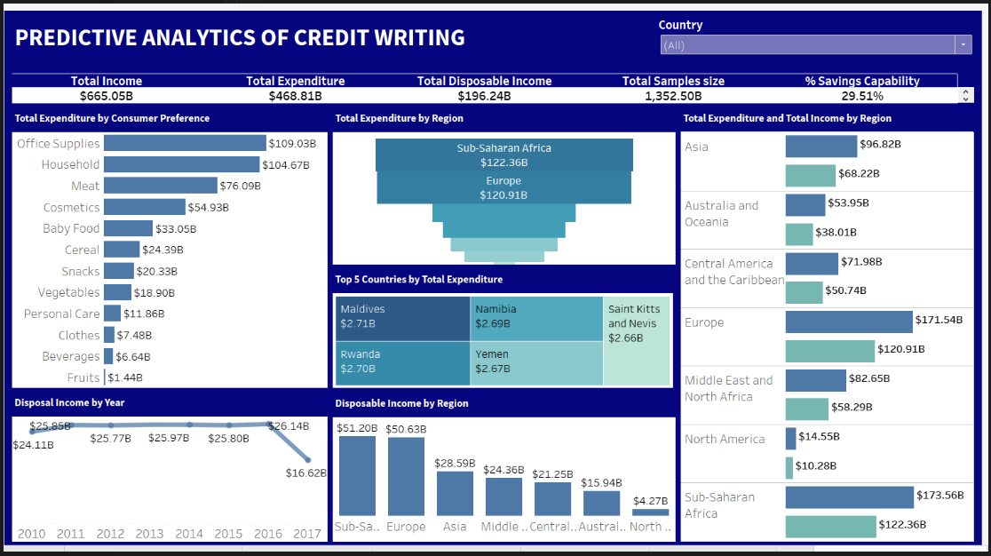
TABLEAU DASHBOARD

Slide 8
LOOKER STUDIO DASHBOARD

Slide 9
From the income and expenditure analysis, it is observed that the spending trends for consumers is the same across the regions and countries irrespective of the income size, so Credpal can do scalability of the credit solutions across all the regions.
Sub-Saharan Africa has the highest income aggregate which also culminate into saving capability, so the higher the disposable income, the more likelihood of having the capacity to save.
Office supplies and household products took the larger share of the total expenditure. This likely means that consumers orientation tilts towards investment in business and housing more than consumables. Therefore, scaling up credit solutions across the regions will be profitable for Credpal.
INSIGHTS

Slide 10
Successful scalability of the Credpal solution as higher disposable incomes connotes higher capability to save and with increased savings comes increased investment. This would create more credit market for Credpal.
We predict an increase in the disposable income of the regions in the next year (2018) given that the crisis which led to a sharp decline in disposable income in 2017 does not reoccur
PREDICTIONS

Slide 11
THANK YOU FOR LISTENING

